Slide 1
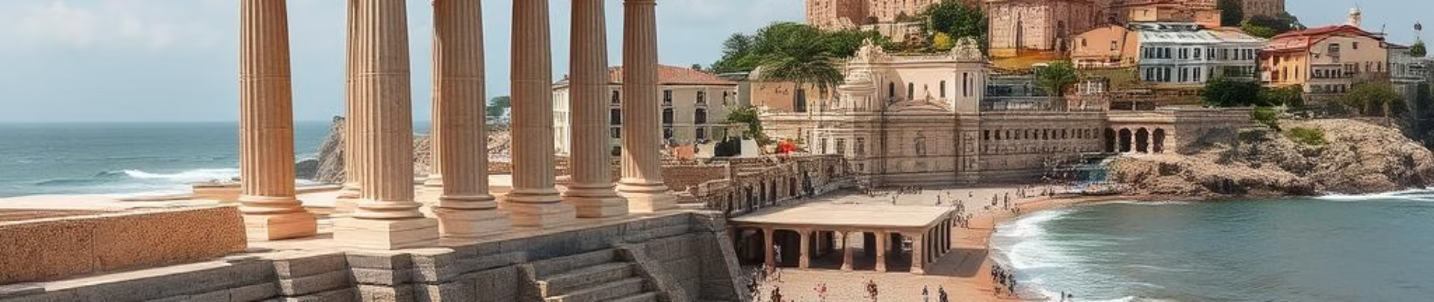
Personalized Travel Recommendation System
Generative AI
Under the guidance of Professor: Aradhya Kishore

Slide 2

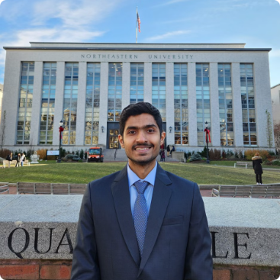


Introduction
Darshil Shah
Ishan
Mitesh Singh
Prarthana Shetty
Joshi

Slide 3
⛰️ Problem Statement
Problem Statement: Planning a trip is often a time-consuming and overwhelming process, requiring users to sift through scattered information across multiple platforms. Travelers struggle to find personalized recommendations. Our research identified five key challenges in current travel planning:
Average users spend 5-7 hours across 8-10 different platforms to plan trips.
67% of travelers experience information overload and decision fatigue.
Pricing data is often outdated or inconsistent across platforms.
Recommendations lack context about nearby attractions or dining options.
Personal preferences are often lost in generic ratings and review scores.

Slide 4
💡Solution
We wanted to simplify and enhance travel planning by creating TravelGenie, which integrates Graph Retrieval Augmented Generation (GraphRAG) with semantic search and natural language processing. Using a sophisticated knowledge graph and AI-driven automation, we aimed to provide precise, personalized recommendations and generate optimized itineraries in just minutes, reducing the effort and time required for travel planning. Our solution, TravelGenie, addresses these challenges through an innovative approach combining:
Natural Language Processing (NLP) for intuitive and seamless user interactions.
Knowledge Graph Technology for contextual and interconnected travel insights.
Advanced Data Engineering to ensure accurate, up-to-date information.
Machine Learning for highly personalized and optimized recommendations.

Slide 5
DEMO

Slide 6
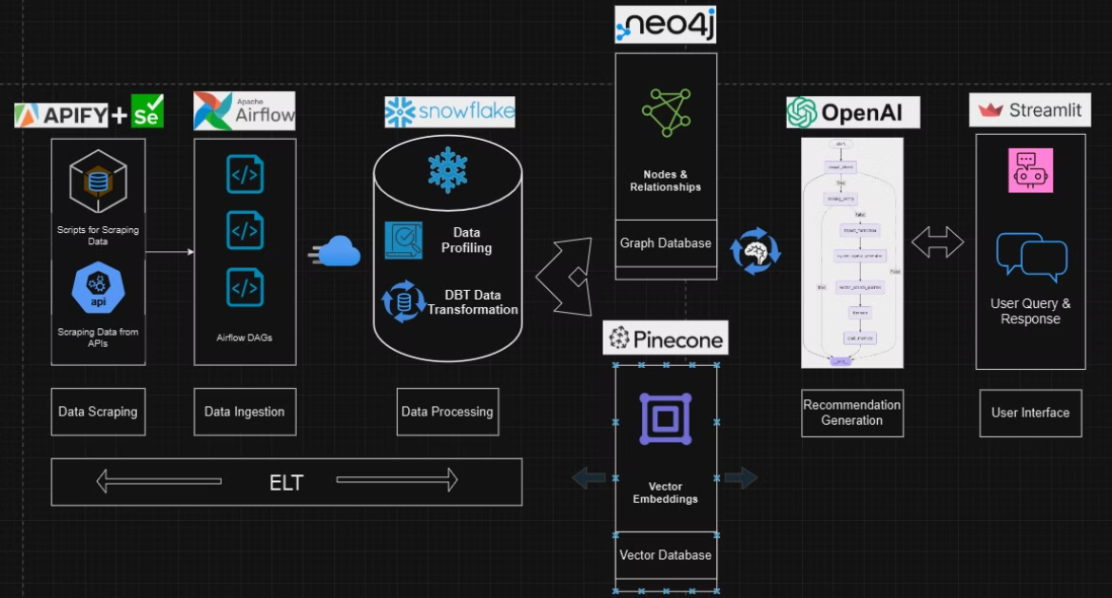
Architecture

Slide 7
⛰️ Explanation
We scraped travel data using APIFY APIs and Selenium scripts to collect details about attractions, hotels, and restaurants
Used Apache Airflow DAGs to streamline data ingestion
Processed and transformed data in Snowflake with DBT for profiling and structuring
Built a Neo4j Knowledge Graph to map entities (hotels, attractions) and their relationships
Integrated OpenAI LLMs to query the graph and generate personalized recommendations
Designed a Streamlit interface to provide users with real-time, interactive travel suggestions
Managed the entire data flow using ETL pipelines to ensure seamless extraction, transformation, and loading of data into Snowflake and Neo4j

Slide 8
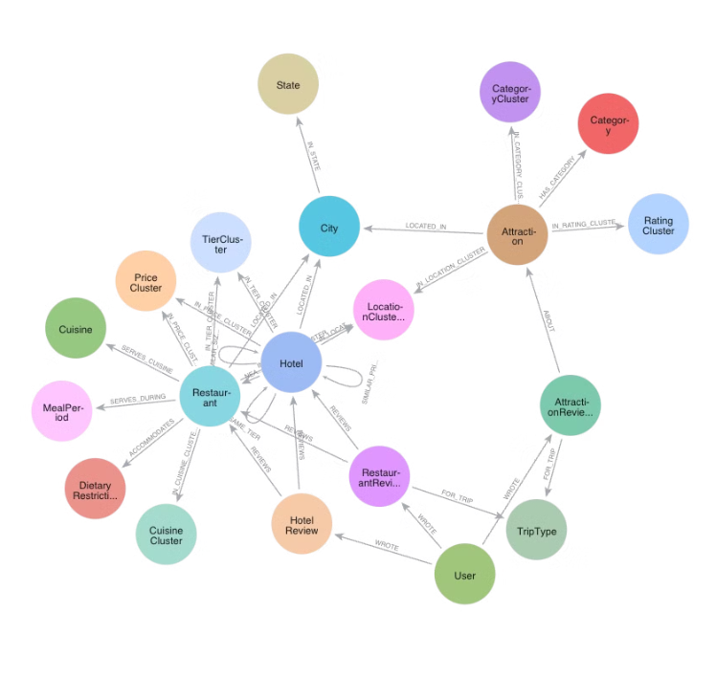
Knowledge Graph
Hotel entities sit at the center, connecting to essential attributes like Price Cluster, TierClass, and Location, allowing us to understand accommodations in their full context, from luxury status to neighborhood characteristics. Attractions and Restaurant entities link to both the City node and various classification clusters (Category, Rating, Cuisine), enabling us to find, for example, highly-rated Italian restaurants near historical landmarks. User interactions are captured through Review nodes and TripType classifications, which connect to both the places and the users, helping us understand travel preferences and provide personalized recommendations. The hierarchical structure from Hotel/Restaurant/Attraction through City to State allows for both precise local searches and broader regional exploration, while multiple classification clusters (Price, Rating, Category) enable sophisticated filtering.

Slide 9
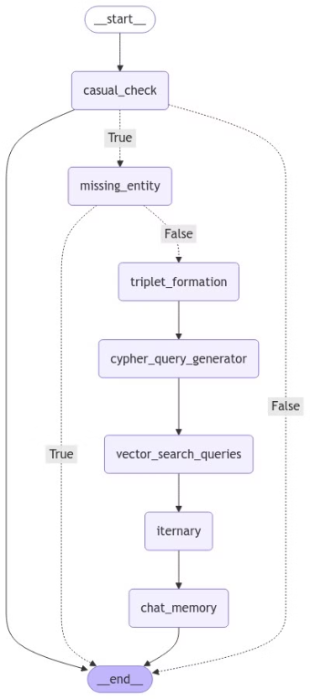
Agentic workflow
Casual Check: Identifies if the conversation is casual or travel-related.
Missing Entity: Detects missing attributes in user input.
Triplet Formation: Extracts entity-relationship triplets from the prompt.
Cypher Query Generator: Converts triplets into Cypher queries for the Knowledge Graph.
Vector Search Queries: Retrieves attraction, hotel, and restaurant reviews.
Itinerary Creation: Generates an itinerary from retrieved data.
Chat Memory: Stores responses in chat history for continuity.

Slide 10

Challenges and Our Key Decisions

Slide 11
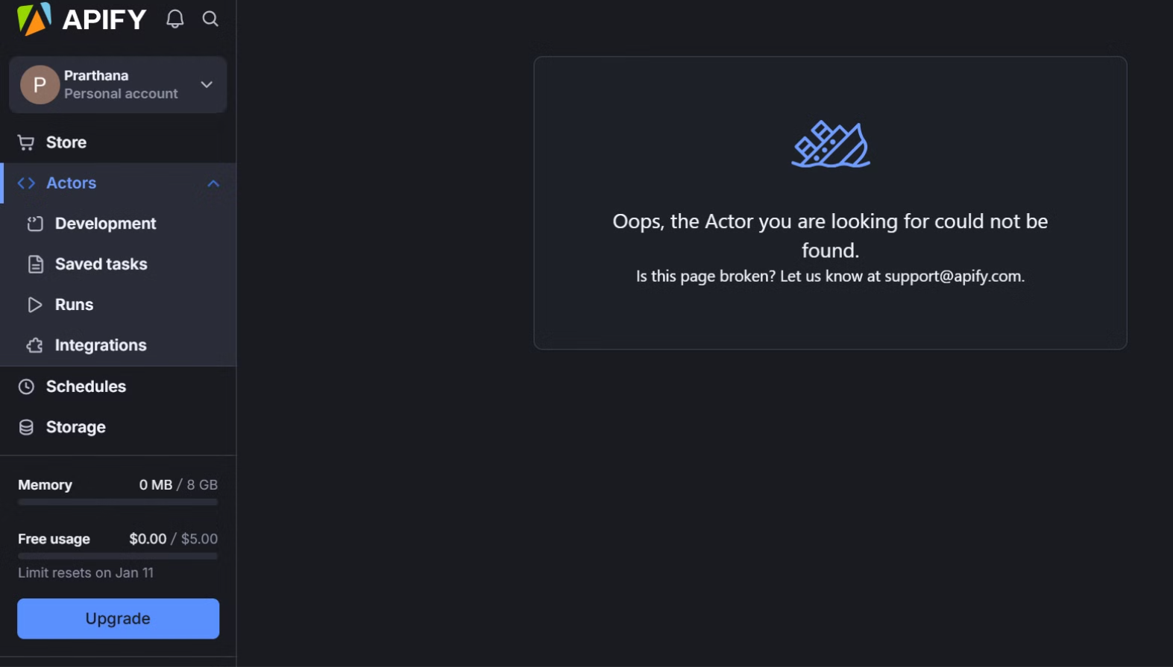
⏱️ Data Availability & Scraping Limitations
Challenge: Limited data availability and APIFY's credit limitations restricted the amount of data we could scrape.
Decision: Carefully designed the schema beforehand to scrape only the most essential and relevant data, optimizing credit usage and ensuring data alignment with project requirements.

Slide 12
💸 Data Quality Inaccuracy
Challenge: Limited and Overlapping Categories
Categories like "Nature and Parks" and "Sites & Landmarks" often overlapped in the raw data, making it difficult to distinguish specific types of attractions.
Decision: We mapped and segregated overlapping categories. For instance, if a single entity (e.g., a beach) had both categories listed in a single column (comma-separated), we segregated them into separate relationships. This allowed us to define two distinct relationships in the schema, refining the data structure for better query precision.
Challenge: Price Data Inaccuracy
Pricing data was inconsistent, with symbols like "$" provided without clear ranges or standardization.
Decision: Standardized pricing ranges using research-based thresholds, transforming symbols into meaningful price tiers (e.g., low, moderate, high). Null values were handled using DBT (Data Build Tool) to ensure downstream processing and analysis were accurate and seamless.

Slide 13
🧱 Neo4j Cost and Scope
Challenge: Cost scaling became a significant concern as our graph grew - AuraDB charges based on memory usage, and with millions of relationships between hotels, attractions, and reviews, we had to carefully optimize our data model to stay within budget constraints. Query performance degraded noticeably when handling complex relationship traversals (like finding hotels near highly-rated restaurants with specific cuisines)
Decision: We had to implement sophisticated caching and query optimization strategies to maintain response times under 2 seconds. The read/write throughput limitations of AuraDB forced us to batch our updates and implement a queue system, especially when refreshing large amounts of review data or updating multiple location relationships simultaneously. Memory management became tricky since AuraDB has fixed memory limits - we had to carefully monitor and optimize our query patterns, especially for operations involving large result sets or multiple relationship traversals that could cause out-of-memory errors.

Slide 14
⛔ Latency in Model Processing
Challenge: Local Hugging Face models had a high processing time (3–4 minutes).
We experiment with Phi3.5-mini-hf, Qwen2.5-3b-instruct, Llama3.2-3b-instruct
Decision: Shifted to OpenAI API integration for faster computation (30–40 seconds), balancing cost with efficiency for real-time usability.

Slide 15
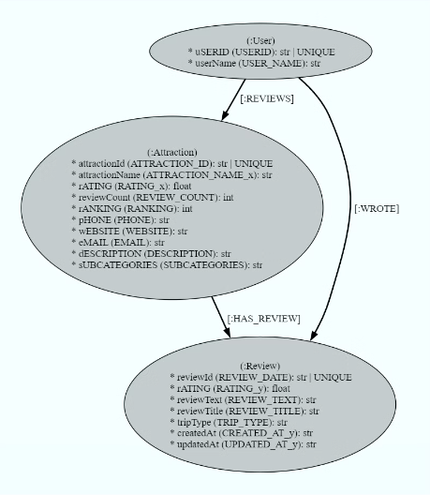
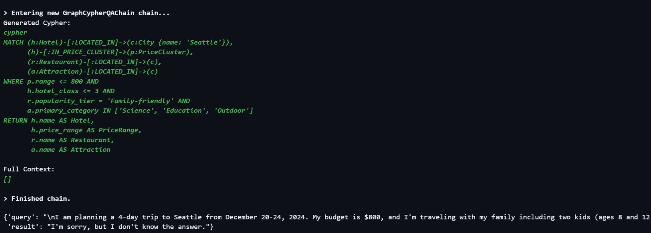
🤝 Initial Knowledge Graph Challenges
Challenge:
Try LLMGraphTransformer and Neo4j Runway's automatic graph-building produced suboptimal nodes and relationships.
Query Data in Knowledge Graph was also an challenge where we implemented with RetrievalQA Chain and GraphCypherQAChain
Decision: Adopted a manual approach to improve entity extraction, triplet generation, and Cypher query creation, resulting in a more robust knowledge graph.

Slide 16

References
1
​​https://www.expedia.com/newsroom/eg-path-to-purchase-research/​​
2
​https://www.phocuswire.com/how-generative-ai-can-tackle-information-overload-empower-travelers
3
Build a basic LLM chat app - Streamlit Docs

